Slide 1
Customer Retention
Of Indian E-commerce websites

Slide 2
Contents
Introduction
Definition of Customer Retention
Benefits of Customer Retention
EDA
Analysis
Conclusion
Limitation and Assumptions

Slide 3
Introduction
In this PPT we will be looking at the analysis I have done to retain customers for an Indian e-commerce company.
We will also be looking at the expectations of the customer on a good e-commerce website

Slide 4
What is Customer Retention?
Customer retention refers to the activities and actions companies and organizations take to reduce the number of customer defections.
It is important to remember that customer retention begins with the first contact a customer has with a company and continues throughout the entire lifetime of the relationship.
The goal of customer retention programs is to help companies retain as many customers as possible, often through customer loyalty and brand loyalty initiatives.

Slide 5
Benefits Of Customer Retention
Retention is Cheaper than Acquisition
Loyal Customers are More Profitable
You’ll Earn More Word of Mouth Referrals
Customers Will Explore Your Brand
Loyal Customers are More Forgiving
Repeat Purchases Means Repeat Profit.
Lower Marketing Costs.
Boosts the brand reputation and popularity

Slide 6
Exploratory Data Analysis(EDA)
Checked the null values and found no null values in the dataset.
Performed both univariate and bivariate analysis and visualized each feature using seaborn and matplotlib libraries by plotting count plot, pie plot, and box plts.

Slide 7
Data And Assumptions
The gathered data contains 269 surveyors and 71 answers from each one of them
Few of the questions that have been asked fall in the following categories:
How was the online purchase made
Important factors for making purchase decision and drives satisfaction
The basic information of the population.
Which e-commerce sites satisfies the above factors to make purchase decision and drives satisfaction
The Assumption for this analysis is that, when we recommend something to a friend, it is most likely that we are using it, we will be using it in future and we are satisfied with the service/experience we’ve received.

Slide 8
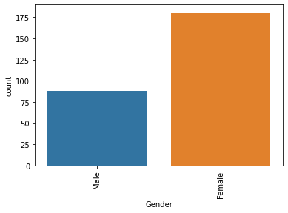
Analysis
We can see that most of the customers that us e-commerce websites for making purchases are women.

Slide 9
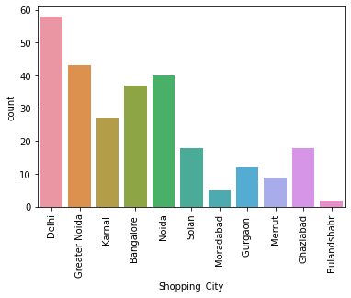
Analysis
From our analysis we have also found out that most of the customers are from the capital city Delhi

Slide 10
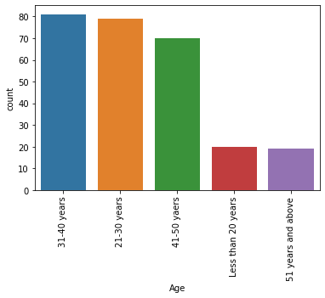
Analysis
Maximum count of the customers using the e-commerce portals are between the age 21 and 40 years.
Least count of customers are below the age of 20 years.

Slide 11
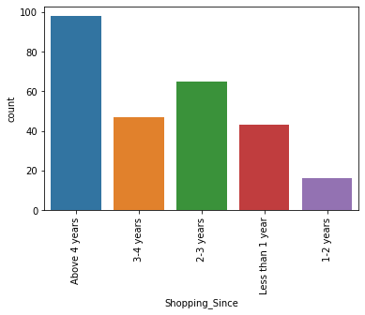
Analysis
Many customers have been shopping for more than 4 years while only a few customers have been shopping from the past 1-2 years

Slide 12
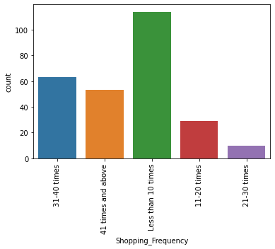
Analysis
Most of the customers shop less than 10 times using e-commerce websites like Flipkart, Amazon, Snapdeal, Paytm.
Very few customers have shopped about 21-30 times.

Slide 13
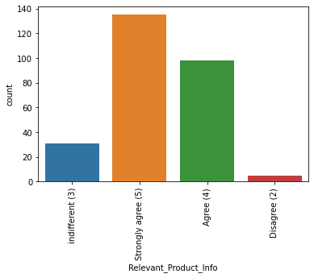
Analysis
Most of the customers strongly agree that the product information provided is relevant.

Slide 14
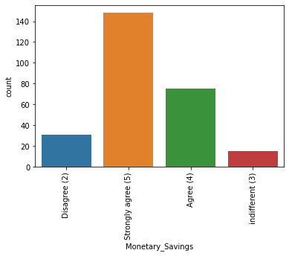
Analysis
Most of the customers strongly agree that they save a lot of money by making purchases on the e-commerce websites.

Slide 15
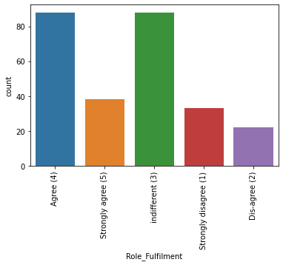
Analysis
A large count of customers agree that their the role of e-commerce have helped them a lot.

Slide 16
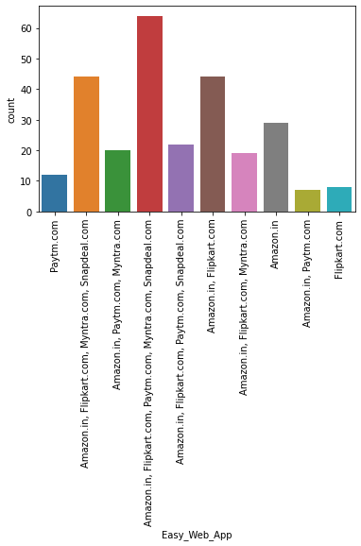
Analysis
We see the bars of the individual e-commerce websites, that is Amazon, Flipkart, Snapdeal, and Paytm, we can see that most of the customers say that Amazon.com has an easy web app (easy to use)

Slide 17
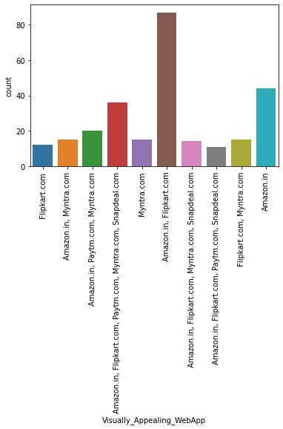
Analysis
Maximum number of customers say that the Amazon.in and Flipkart.com websites are the most visually appealing.

Slide 18
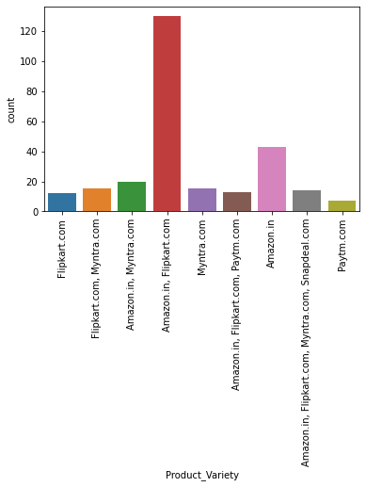
Analysis
We can see that about 120 customers say that Amazon.in and flipkart.com have a wide product variety when compared to the other e-commerce websites.

Slide 19
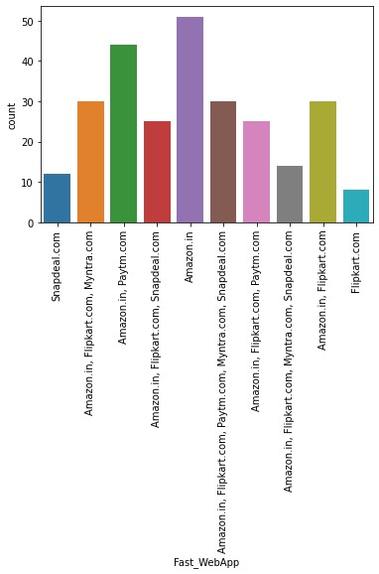
Analysis
Most customers say that Amazon.in has a fast web app followed by Amazon.in and Paytm combined.

Slide 20
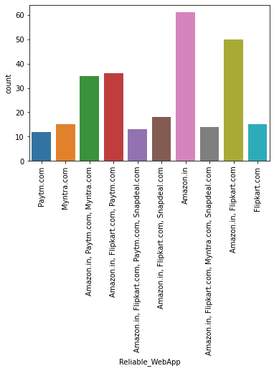
Analysis
Most of the customers(about 60) say that Amazon.in is the most reliable web app that is available.

Slide 21
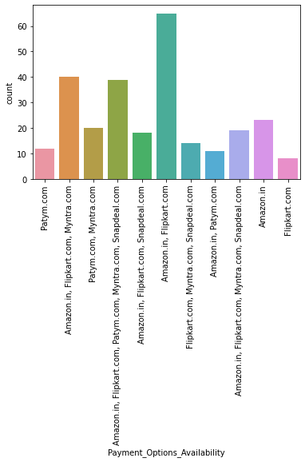
Analysis
A large number of customers say that Amazon.in and Flipkart.com have a feasible payment method.

Slide 22
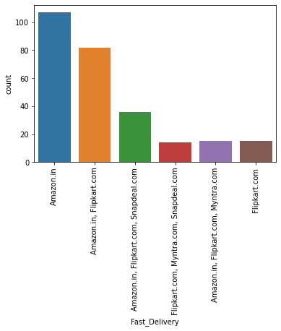
Analysis
Amazon.in has the fastest delivery when compared to the other e-commerce websites as answered by the customers.

Slide 23
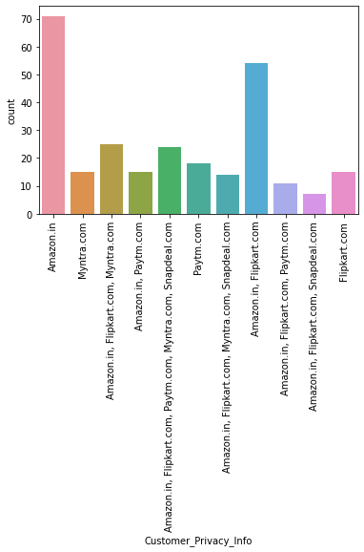
Analysis
Customers say that they trust Amazon.in the most when is comes to protecting the privacy of the customer.

Slide 24
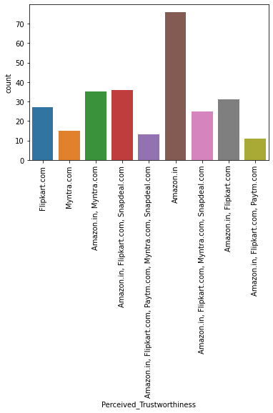
Analysis
Finally, most of the customers agree that Amazon.in is most trustworthy website that is available.

Slide 25
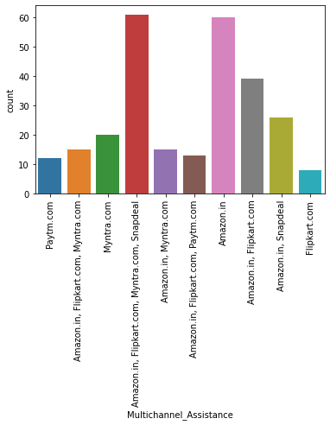
Analysis
Here we can observe that all the 4 e-commerce websites that is Flipkart, Amazon, Snapdeal, and Paytm have ben voted that they have multiple channels for making purchases.

Slide 26
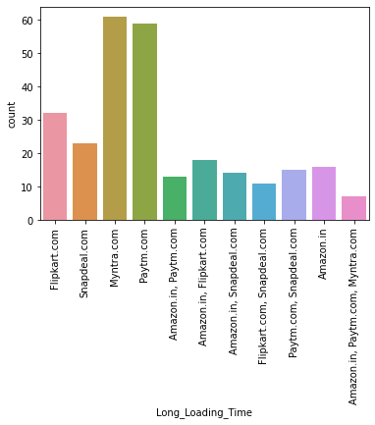
Analysis
Here we can see that the websites Myntra and Snapdeal take a long time to load.

Slide 27
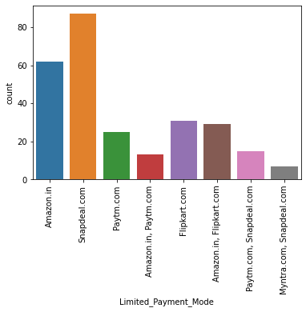
Analysis
Customers say that Snapdeal.com has a very limited number of payment methods.

Slide 28
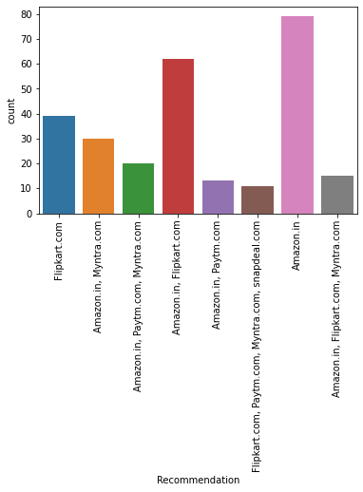
Analysis
Finally, we can see that a large number of customers recommend Amazon.in over the other e-commerce websites.

Slide 29
Conclusion
As per my analysis, I can say that the companies with highest retention and customer satisfaction rates are Amazon.in and Flipkart.com because their positives are in line with the customer preferences and they are most likely to use these websites for purchases in the future.
The company with very low retention rate and customer satisfaction is with Paytm and Snapdeal because most of the factors are not in line with the customer preferences
Finally I would say that, customer satisfaction plays a major role in retention, A company should first understand what customers expects while purchasing online (e-commerce) and build a better buying experience which will in turn retain the customer.
It was also observed that online shopping is not trustworthy and reliable to some consumers because of only online payment mode and personal privacy.

Slide 30
Limitation and Assumption
I would say that the quantity of data we used to analyse the customer retention was moderate.

